Slide 1
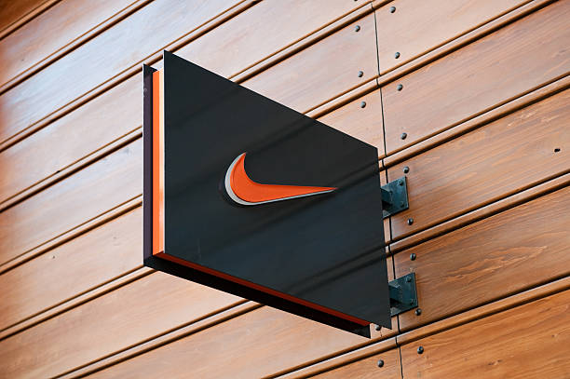
MARKETING WEB ANALYTICS AND INSIGHTS PROJECT
(MKT 6352.001)
GROUP 11
Premi Jawahar Vasagam, Natasha Mehta, Neelima Nandigam, Prerna Dhingra, Prriyamvradha Parthasarathi, Mira Radhakrishnan

Slide 2
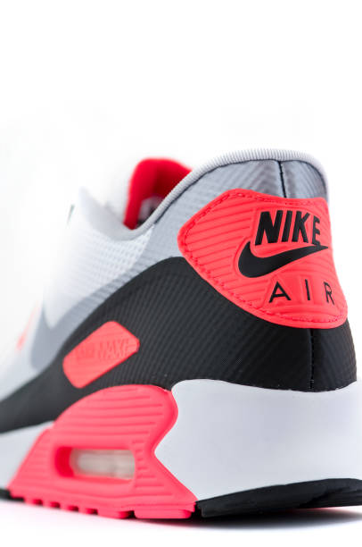
NIKE
OUR COMPANY

Slide 3
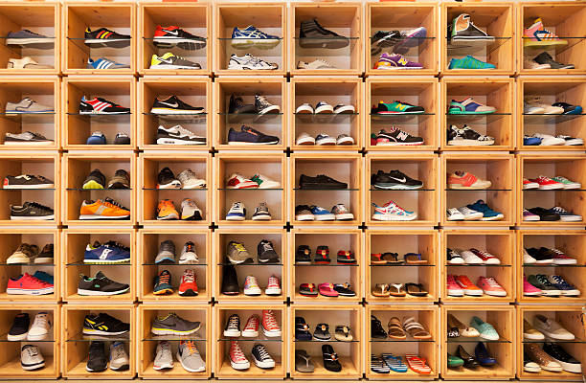
COMPANY OVERVIEW
Nike, Inc. is an American multinational association that is involved in the design, development, manufacturing and worldwide marketing and sales of apparel, footwear, accessories, equipment and services. Nike, originally known as Blue Ribbon Sports (BRS), was founded by University of Oregon track athlete Phil Knight and his coach, Bill Bowerman, on January 25, 1964. Headquartered at Oregon, it is a major producer of sports equipment and one of the world’s largest suppliers of athletic shoes and apparel. Apart from its own brand, Nike market its products under Nike Pro, Nike+, Nike Golf, Nike Blazers, Air Jordan, Air Max and other as well as subsidiaries including brands Jordan, Hurley Int. and Converse.
Nike’s mission statement is “to bring inspiration and innovation to every athlete in the world.”
And Nike‘s vision statement is “to do everything possible to expand human potential.”

Slide 4
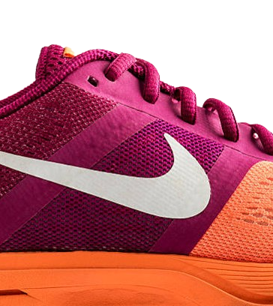
BUSINESS OBJECTIVES
To continue developing and innovating in the space of footwear, apparel, and technology’ thereby expanding its market leadership and increasing revenue and profitability
Building and strengthening relationships with consumers by delivering high-quality products and exceptional customer experiences
Embracing technology and digital platforms to enhance customer engagement, streamline operations, and optimize marketing efforts

Slide 5
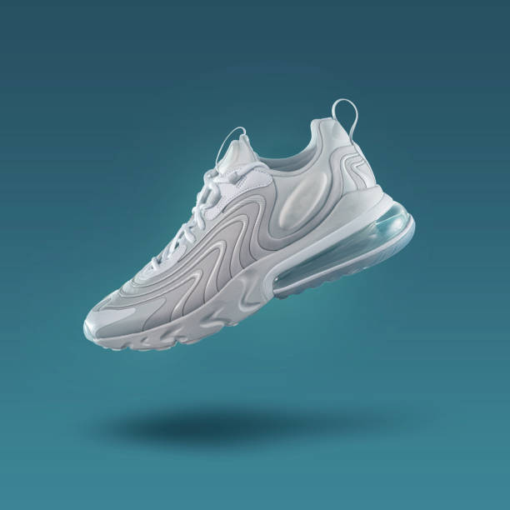
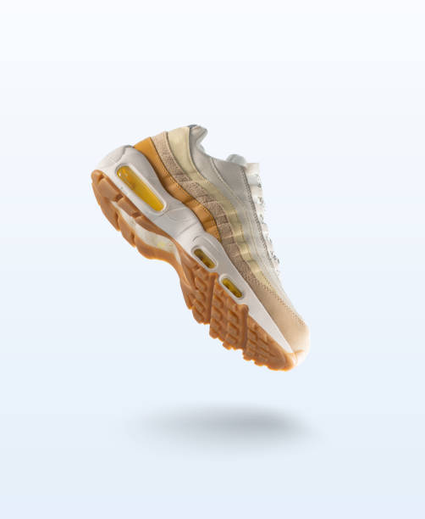
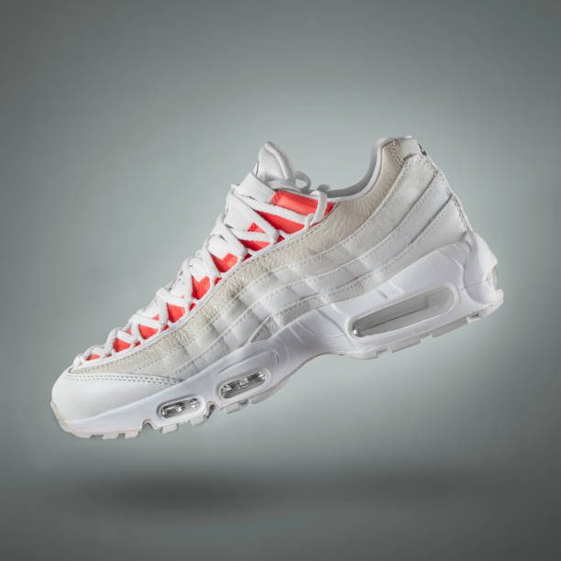
KEY PERFORMANCE INDICATORS
Shopping Behavior
Cart Abandonment by –
Device
Browser
User Type
Bounce Rate
Revenue
Contribution by category
Average Order Value (AOV)
Conversion Rate
Session (Visits)
Session by –
Marketing Channel
Device
Page

Slide 6
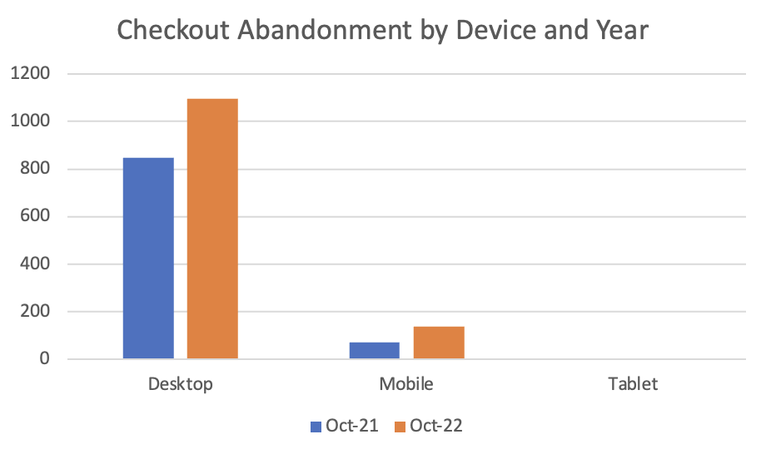
CHECKOUT ABANDONMENT by Device
Checkout Abandonment
Device | Date | Check-out Abandonment
Desktop | Oct-22 | 1096
Desktop | Oct-21 | 848
% Change |  | 29.25%
Mobile | Oct-22 | 135
Mobile | Oct-21 | 70
% Change |  | 92.86%
Tablet | Oct-22 | 3
Tablet | Oct-21 | 2
% Change |  | 50.00%
Observations:
Desktop has the highest checkout abandonments for both years followed by mobile; negligible checkout abandonments for tablet
Across both desktop and mobile checkout abandonments have increased for Oct ‘22 compared to Oct ‘21

Slide 7
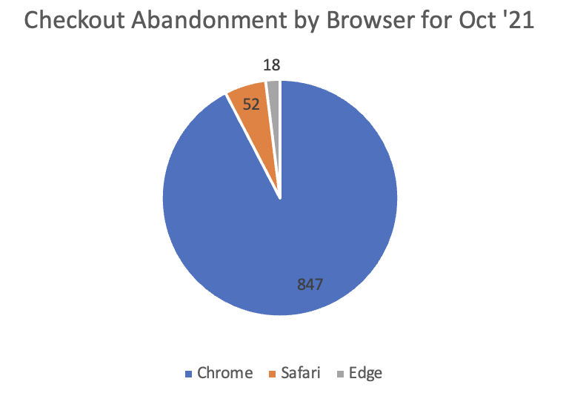
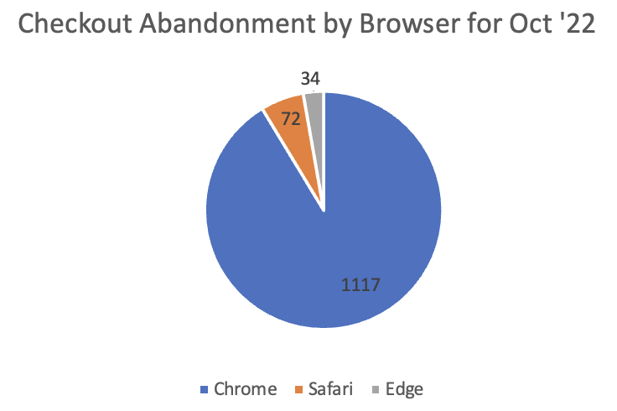
CHECKOUT ABANDONMENT by Browser
Checkout Abandonment
Browser | Date | Check-out Abandonment
Chrome | Oct-22 | 1117
Chrome | Oct-21 | 847
% Change |  | 31.88%
Safari | Oct-22 | 72
Safari | Oct-21 | 52
% Change |  | 38.46%
Edge | Oct-22 | 34
Edge | Oct-21 | 18
% Change |  | 88.89%
Observations:
Most of the checkout abandonment is observed for the Chrome browser followed by Safari and Edge
Even though the percent change from Oct ‘21 to Oct ‘22 is the least for Chrome (31%), it overall still accounts for a large number of checkout abandonments

Slide 8
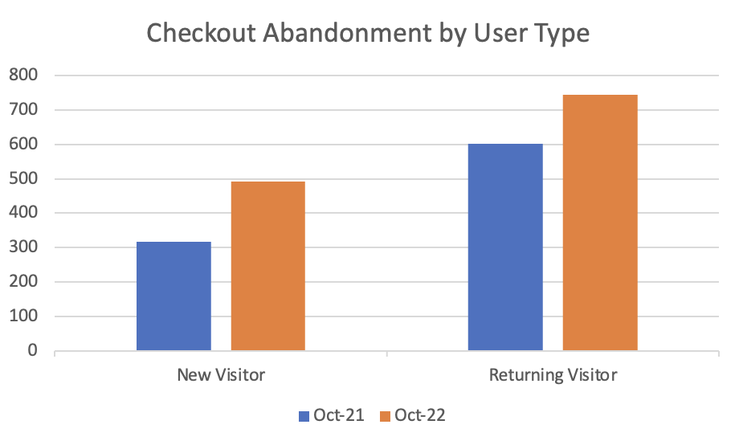
CHECKOUT ABANDONMENT by User Type
Checkout Abandonment
User Type | Date | Check-out Abandonment
New Visitor | Oct-22 | 491
New Visitor | Oct-21 | 318
% Change |  | 54.40%
Returning Visitor | Oct-22 | 743
Returning Visitor | Oct-21 | 602
% Change |  | 23.42%
Observations:
Comparing abandonment rate for October 2022 vs October 2021, we can see that, the abandonment rate and increased for both new and returning visitors
Further, we also infer that the rate is almost double for returning visitors compared to new visitors
Even though less brand loyalty is expected from a new visitor, an abandonment rate of ~50% for new visitors and ~20% for returning visitors is still very high and required investigation

Slide 9
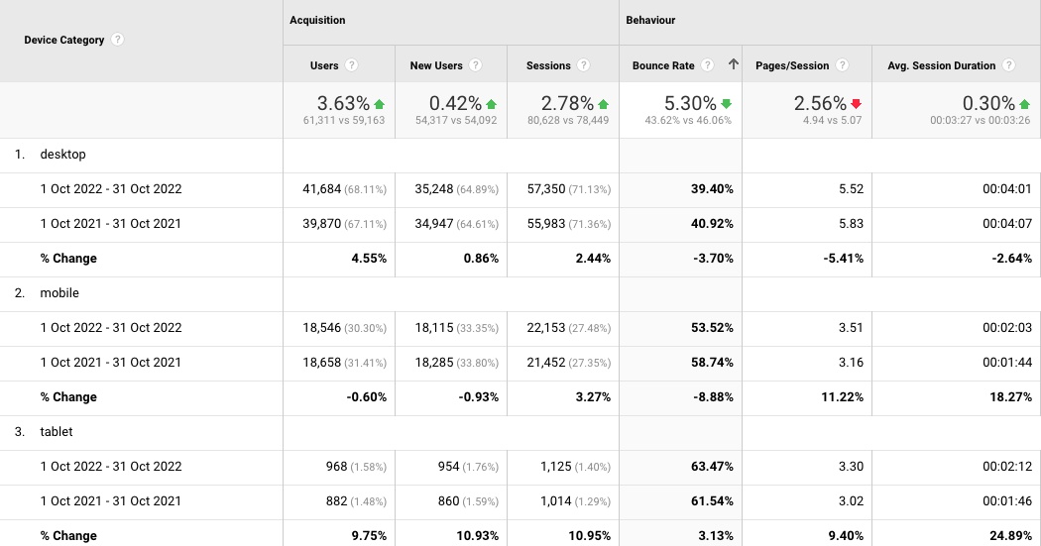
BOUNCE RATE
Observations:
Bounce rate for desktop and mobile has reduced for Oct ‘22 compared to the previous period
Tablet has seen a slight increase in bounce rate, but overall, we are are seeing a ~5% drop in bounce rate

Slide 10
RECOMMENDATIONS
Simplify checkout process making it user friendly; reduce required input fields from users
Offer guest checkout options and don’t restrict free shipping forcing users to create accounts
Include multiple payments options
Add product thumbnails and hyperlink product description page to the product image allowing users the chance to do a final check or changes to the product added

Slide 11
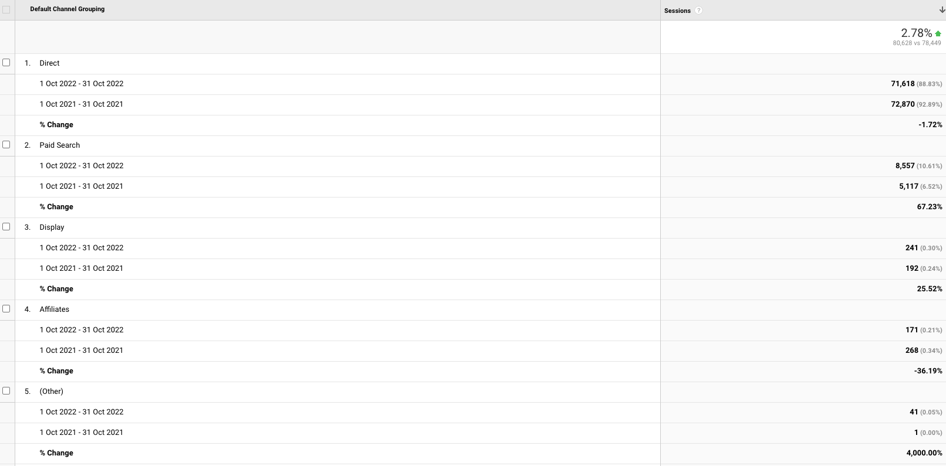
SESSIONS by Marketing Channel
Observations:
From all the marketing channels, direct has the maximum number of sessions followed by paid search and display
Comparing October 2022 to 2021, direct had almost same number of sessions which contributed to the overall increase in sessions by 3%
67% increase in sessions for paid search and 25% increase for display in October ‘22 compared to previous period
Affiliates saw a major drop in sessions by 35%; analyze for change in traffic and assess content

Slide 12
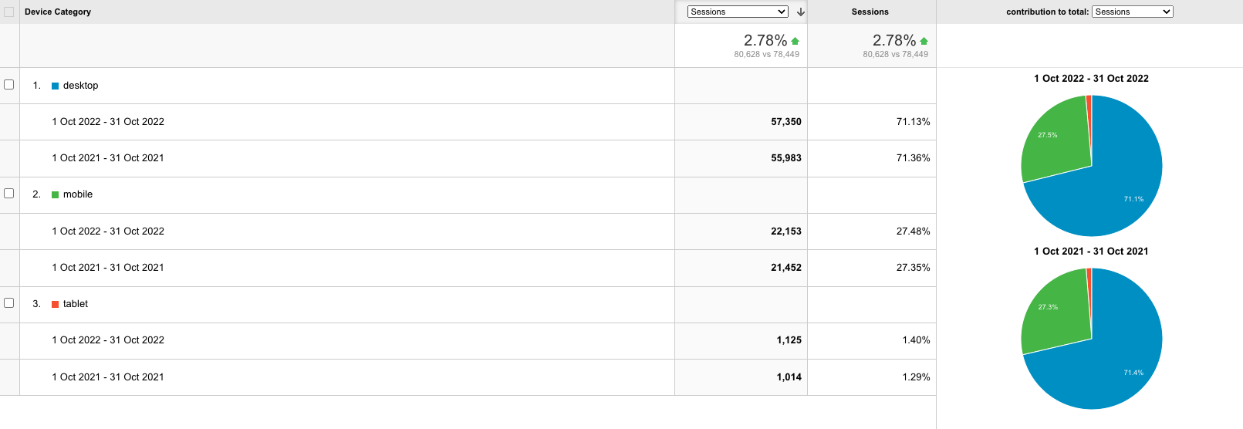
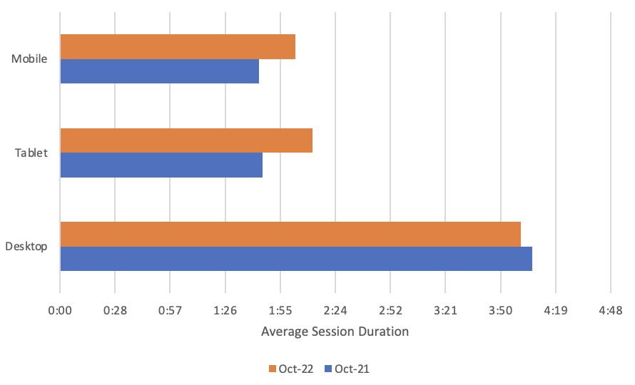
SESSIONS by Device
Observations:
Across all devices, desktop has maximum sessions across both periods and average contribution of ~71% followed by mobile (~27%) and tablet (~1.5%)
Compared to Oct 2021, we have seen an overall ~3% increase in sessions across all devices in October 2022
There was a slight drop in average session duration across desktop in October ’22 compared to ’21 while the average duration increase on both mobile and tablet

Slide 13
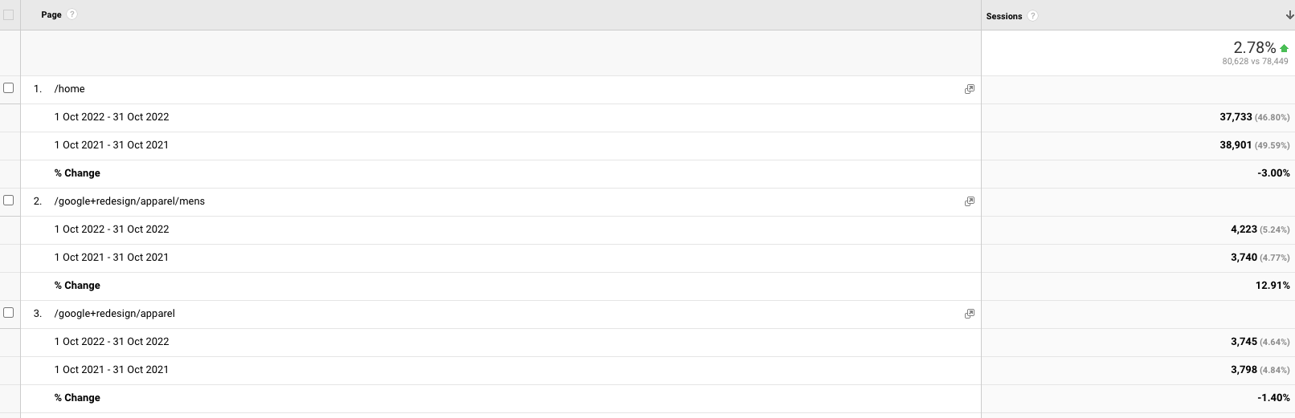
SESSIONS by Page
Observations:
Overall, there was a ~3% increase in session in October 2022 compared to the previous period
The top 3 pages were homepage, men’s apparel and apparel page
While there was a slight drop in sessions on the homepage (3%) and apparel page (~2%), men's apparel saw a significant rise of 12% in October ‘22

Slide 14
RECOMMENDATIONS
Even though direct search has maintained number of visits in both years, it is a good idea to invest in marketing effects that build brand visibility; this could include a new product or limited-edition product line, or an athlete collaborated product line
The homepage should be optimized with relevant keywords and include meta tags, headers etc
The homepage should also have a prominent and attention-grabbing call to action (CTA) such as a waitlist signup for a limited-edition product line

Slide 15
WATERFALL TABLE
 | Oct-21 | Oct-22 | % vs October 2021 | # vs October 2021 | Impact on Revenue
Revenue | $221,776.96 | $199,434.25 | -10.07% | ($22,342.71)
Visits | 78,449 | 80,628 | 2.78% | 2,179 | $6,151.01
Conversion | 2.99% | 2.07% | -30.77% | -0.92% | ($68,138.60)
AOV | $94.41 | $119.21 | 26.27% | $24.80 | $58,171.50
 |  |  |  |  | ($3,816.09)
Observations:
We have seen a 10% drop in revenue in October 2022 compared to October 2021. While AOV drastically increased by ~26%, we saw a huge drop of ~30% in conversions. Visits also saw a slight increase compared to October 2021. Overall, revenue saw a negative impact of $3816 due a significant drop in conversion rate

Slide 16
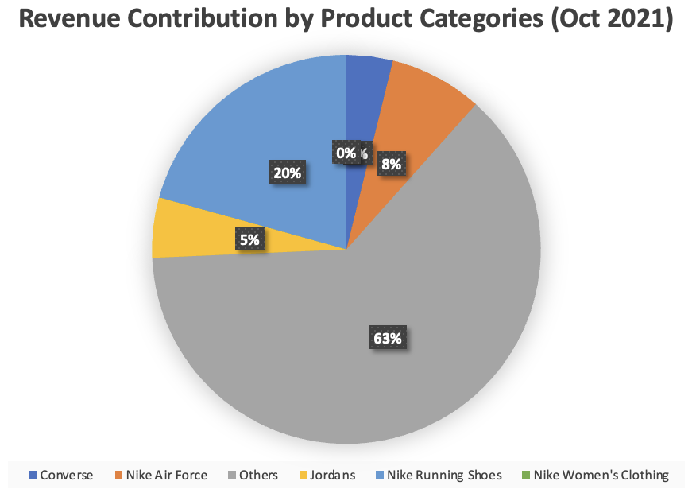
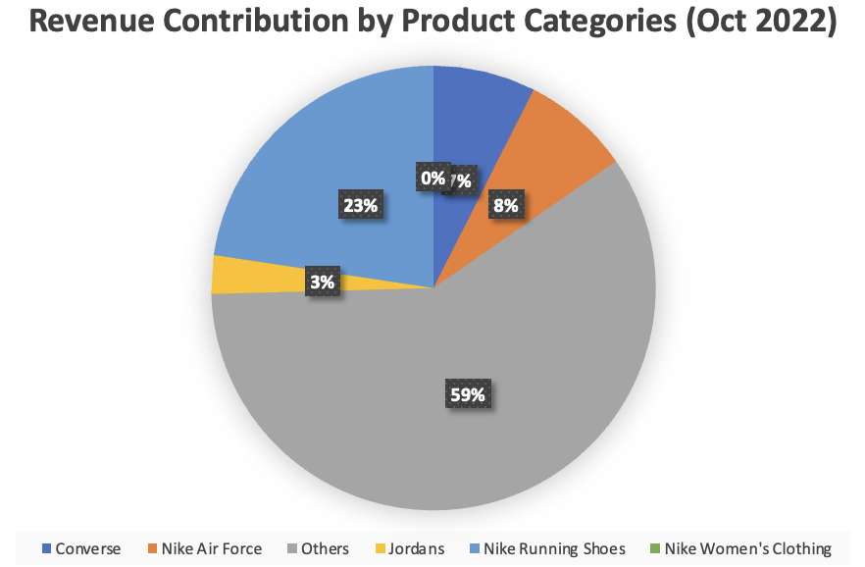
REVENUE by Product Category
Observations:
The ‘others’ category contributes to most of the revenue due to the diversity in products sold by Nike
Nike running shoes has consistently contributed to about 20% in both years with a slight increase in revenue in October ’22
Converse has also seen a significant increase in revenue contribution from 4% to 7% from October 2021 to 2022 while Jordans have seen a drop in the same period

Slide 17
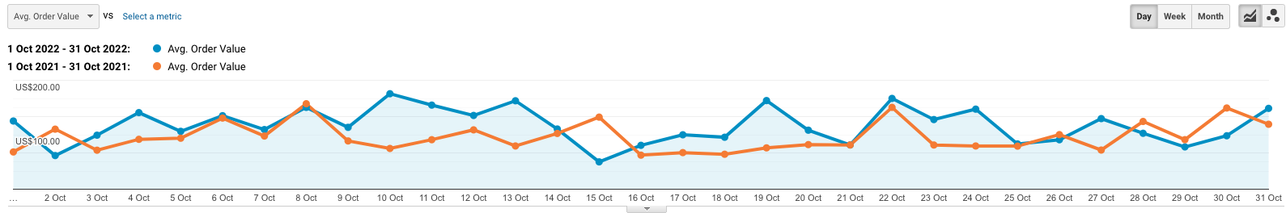
AVERAGE ORDER VALUE (AOV)
Observations:
The AOV for October 2021 was $94.41 while the AOV significantly increased by ~26% to $119.21 in October 2022

Slide 18
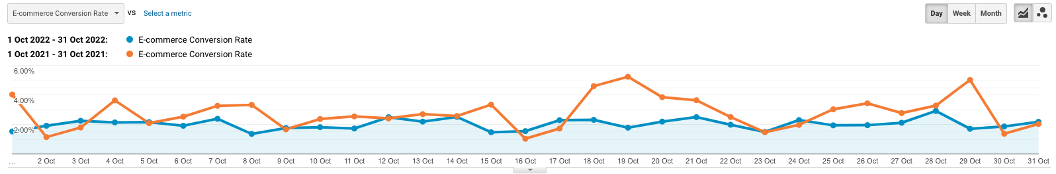
CONVERSION RATE
Observations:
We have seen a 30% drop in conversion rate from 2.99% in October 2021 to 2.07% in October

Slide 19
RECOMMENDATIONS
Conduct A/B testing to test different variations for parts of the website like layouts, colors, headlines, and CTAs
Create user appealing landing pages representing different marketing campaign, product launch announcement, or a new product line link
Improving site speed on desktop as well as a mobile friendly website can prevent users from leaving the site thus negating the impact on conversions
Users are more likely to stick around, explore the website, and make a purchase when their visit is simplified by showing product recommendations based on historic user behavior and preferences

Slide 20
THANK YOU

